Slide 1
Forward Propagation & Backward Propagation

Slide 2
Outlines:
Activation Function
Bias
Forward Propagation [Feed Forward Neural Network]
Backpropagation [Recurrent Neural Network]

Slide 3
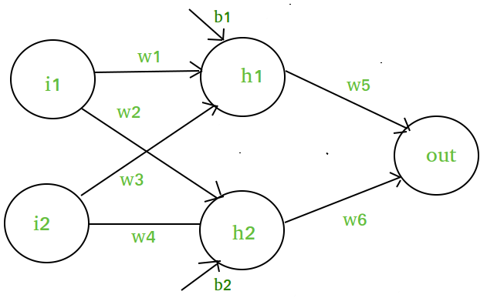
Activation functions in Neural Networks
What is an activation function and why use them?
The activation function decides whether a neuron should be activated or not by calculating the weighted sum and further adding bias to it. The purpose of the activation function is to introduce non-linearity into the output of a neuron.
Explanation: We know, the neural network has neurons that work in correspondence with weight, bias, and their respective activation function. In a neural network, we would update the weights and biases of the neurons on the basis of the error at the output. This process is known as back-propagation. Activation functions make the back-propagation possible since the gradients are supplied along with the error to update the weights and biases.
Why do we need Non-linear activation function?
A neural network without an activation function is essentially just a linear regression model. The activation function does the non-linear transformation to the input making it capable to learn and perform more complex tasks.
Mathematical proof
Suppose we have a Neural net like this :-

Slide 4
Elements of the diagram are as follows:
Hidden layer i.e. layer 1:
z(1) = W(1)X + b(1) a(1)
Here,
z(1) is the vectorized output of layer 1
W(1) be the vectorized weights assigned to neurons of hidden layer i.e. w1, w2, w3 and w4
X be the vectorized input features i.e. i1 and i2
b is the vectorized bias assigned to neurons in hidden layer i.e. b1 and b2
a(1) is the vectorized form of any linear function.
Layer 2 i.e. output layer :-
Note : Input for layer 2 is output from layer 1
z(2) = W(2)a(1) + b(2)
a(2) = z(2)
Calculation at Output layer
z(2) = (W(2) * [W(1)X + b(1)]) + b(2)
z(2) = [W(2) * W(1)] * X + [W(2)*b(1) + b(2)]
Let,
[W(2) * W(1)] = W
[W(2)*b(1) + b(2)] = b
Final output : z(2) = W*X + b
which is again a linear function
This observation results again in a linear function even after applying a hidden layer, hence we can conclude that, doesn’t matter how many hidden layer we attach in neural net, all layers will behave same way because the composition of two linear function is a linear function itself. Neuron can not learn with just a linear function attached to it. A non-linear activation function will let it learn as per the difference w.r.t error. Hence we need an activation function.

Slide 5
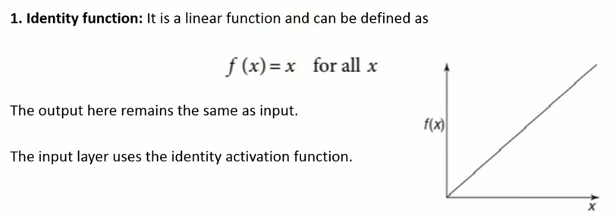
Linear Activation Function:
The equation of the linear activation function is the same as the equation of a straight line i.e.
Y= MX+ C
If we have many layers and all the layers are linear in nature, then the final activation function of the last layer is the same as the linear function of the first layer. The range of a linear function is –infinitive to + infinitive.
Linear activation function can be used at only one place that is the output layer.

Slide 6
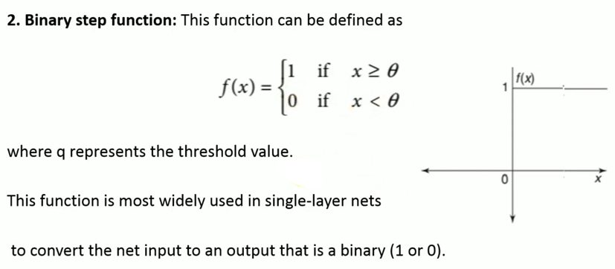
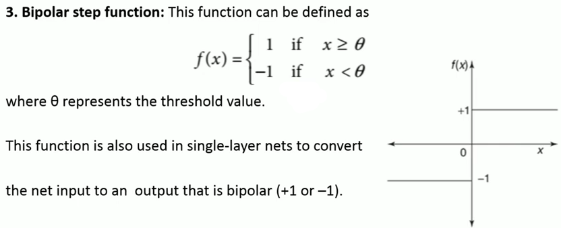
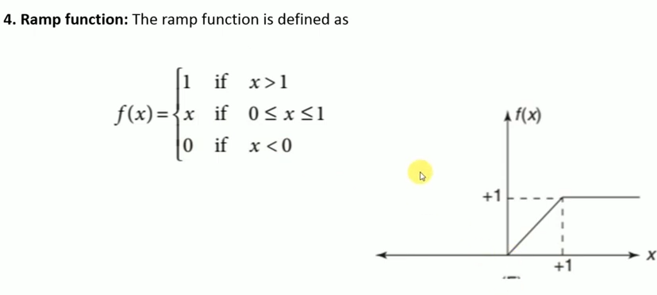
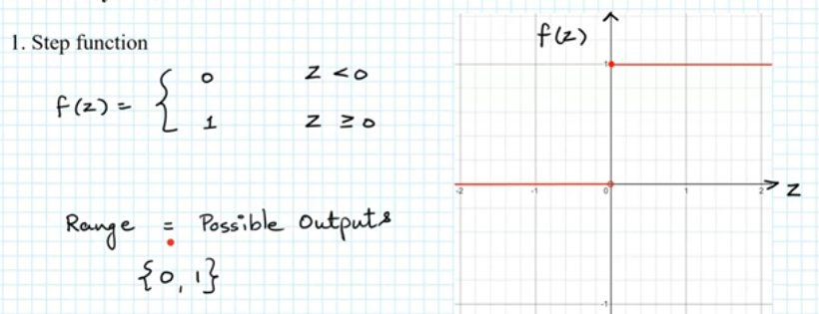

Slide 7
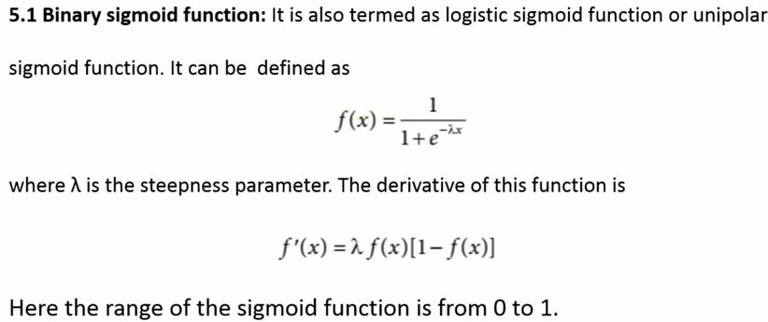
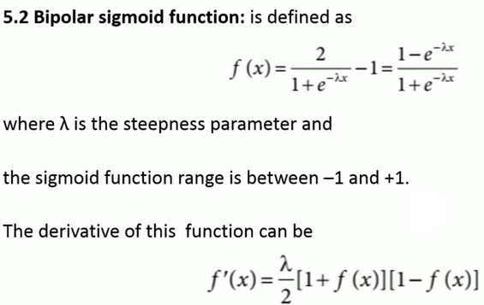
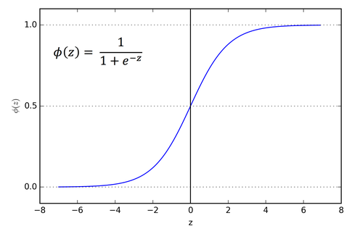
Sigmoid function:
Sigmoid function refers to a function that is projected as S - shaped graph.
A = 1/(1+e^{-x})
This function is non-linear, and the values of x lie between -2 to +2. So that the value of X is directly proportional to the values of Y. It means a slight change in the value of x would also bring about changes in the value of y.

Slide 8
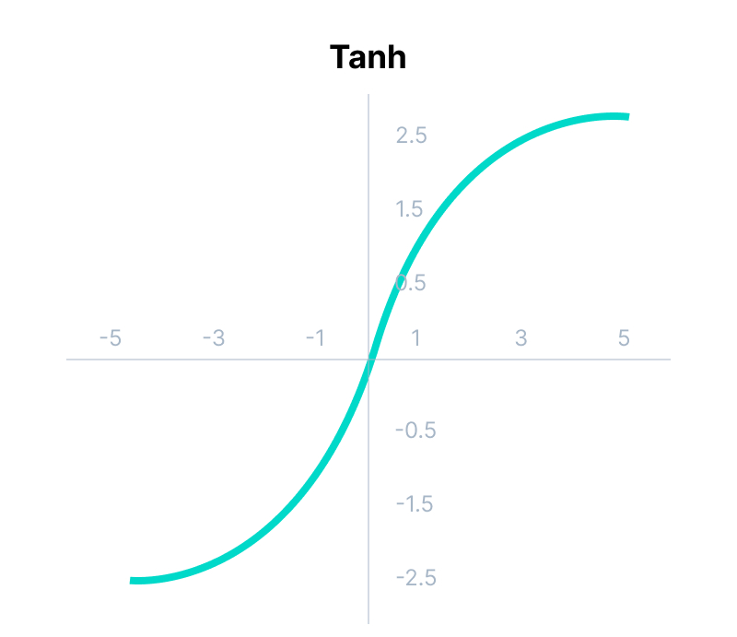
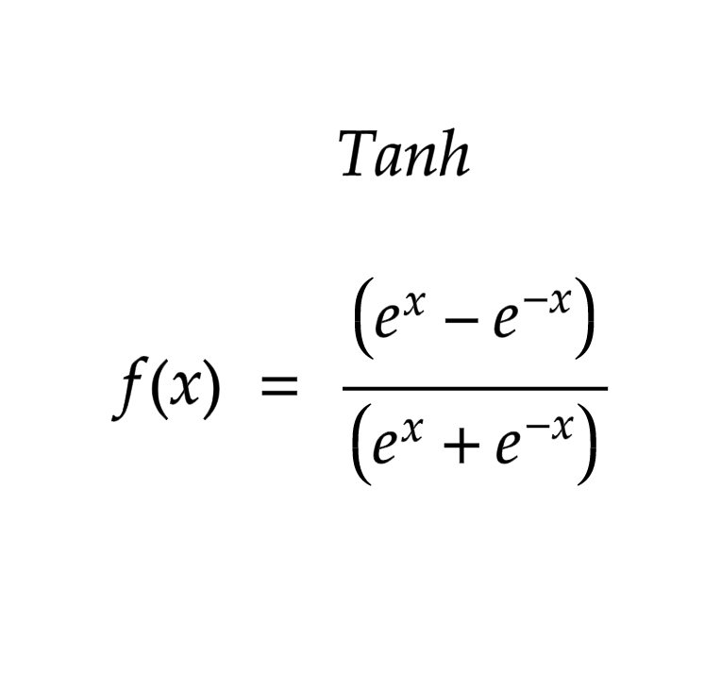
Tanh Function:
The activation function, which is more efficient than the sigmoid function is Tanh function. Tanh function is also known as Tangent Hyperbolic Function. It is a mathematical updated version of the sigmoid function. Sigmoid and Tanh function are similar to each other and can be derived from each other.
F(x)= tanh(x) = 2/(1+e^{-2X}) - 1
OR
Tanh (x) = 2 * sigmoid(2x) - 1
This function is non-linear, and the value range lies between -1 to +1
The activation that works almost always better than sigmoid function is Tanh function also known as Tangent Hyperbolic function. It’s actually mathematically shifted version of the sigmoid function. Both are similar and can be derived from each other.
Equation :- f(x) = tanh(x) = 2/(1 + e-2x) – 1 OR tanh(x) = 2 * sigmoid(2x) – 1
Value Range :- -1 to +1
Nature :- non-linear
Uses :- Usually used in hidden layers of a neural network as it’s values lies between -1 to 1 hence the mean for the hidden layer comes out be 0 or very close to it, hence helps in centering the data by bringing mean close to 0. This makes learning for the next layer much easier.

Slide 9
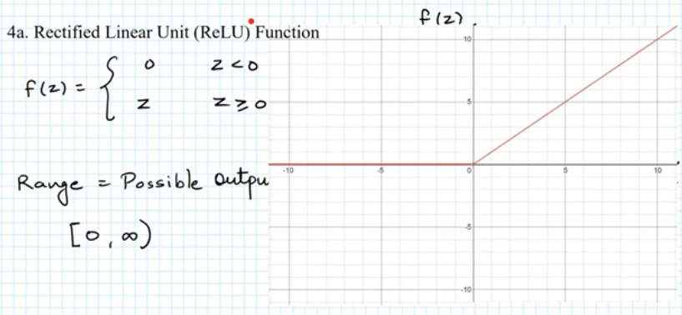
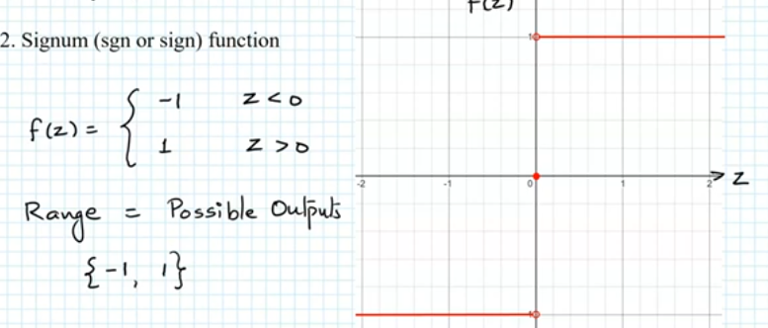
It Stands for Rectified linear unit. It is the most widely used activation function. Chiefly implemented in hidden layers of Neural network.
Equation :- A(x) = max(0,x). It gives an output x if x is positive and 0 otherwise.
Value Range :- [0, inf)
Nature :- non-linear, which means we can easily backpropagate the errors and have multiple layers of neurons being activated by the ReLU function.
Uses :- ReLu is less computationally expensive than tanh and sigmoid because it involves simpler mathematical operations. At a time only a few neurons are activated making the network sparse making it efficient and easy for computation.
In simple words, RELU learns much faster than sigmoid and Tanh function.

Slide 10
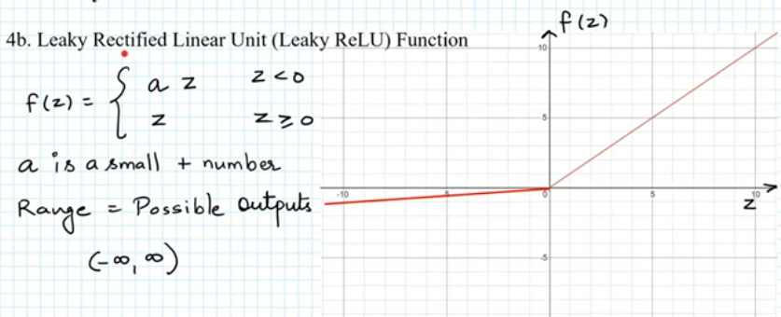
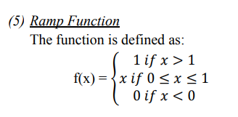
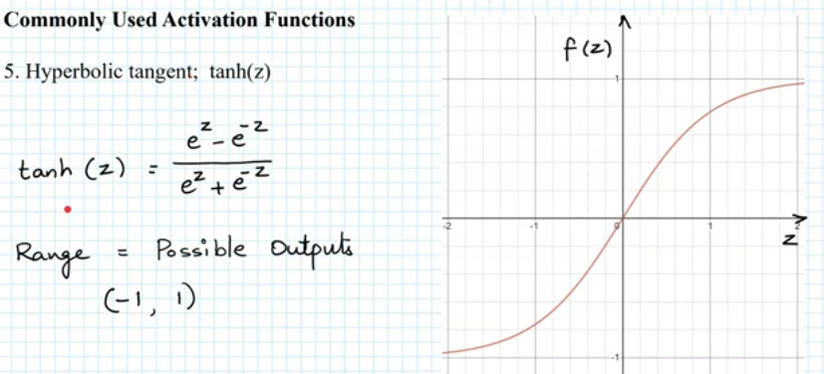

Slide 11
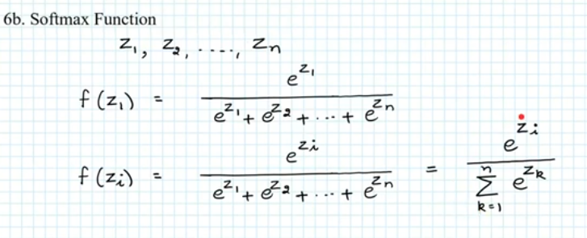
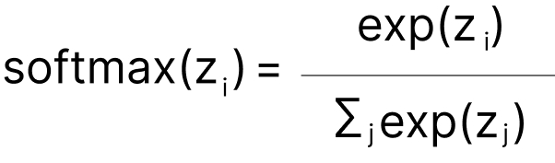
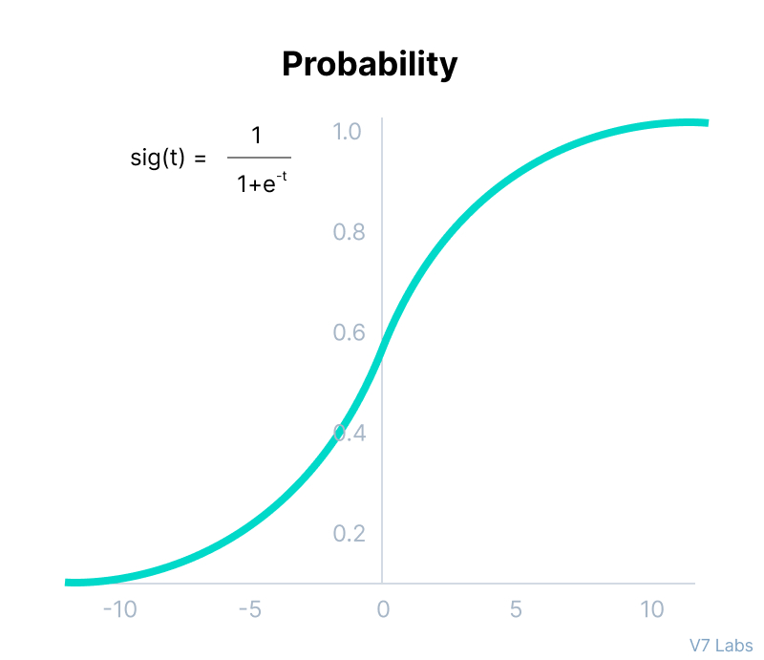
Softmax function calculates the probabilities distribution of the event over ‘n’ different events. In a general way, this function will calculate the probabilities of each target class over all possible target classes. Later the calculated probabilities will help determine the target class for the given inputs.
The softmax function is also a type of sigmoid function but is handy when we are trying to handle multi- class classification problems.
Nature :- non-linear
Uses :- Usually used when trying to handle multiple classes. the softmax function was commonly found in the output layer of image classification problems.The softmax function would squeeze the outputs for each class between 0 and 1 and would also divide by the sum of the outputs.
Output:- The softmax function is ideally used in the output layer of the classifier where we are actually trying to attain the probabilities to define the class of each input.
The basic rule of thumb is if you really don’t know what activation function to use, then simply use RELU as it is a general activation function in hidden layers and is used in most cases these days.
If your output is for binary classification then, sigmoid function is very natural choice for output layer.
If your output is for multi-class classification then, Softmax is very useful to predict the probabilities of each classes.
Used frequently when managing several classes. In the output nodes of image classification issues, the softmax was typically present. The softmax function would split by the sum of the outputs and squeeze all outputs for each category between 0 and 1.

Slide 12
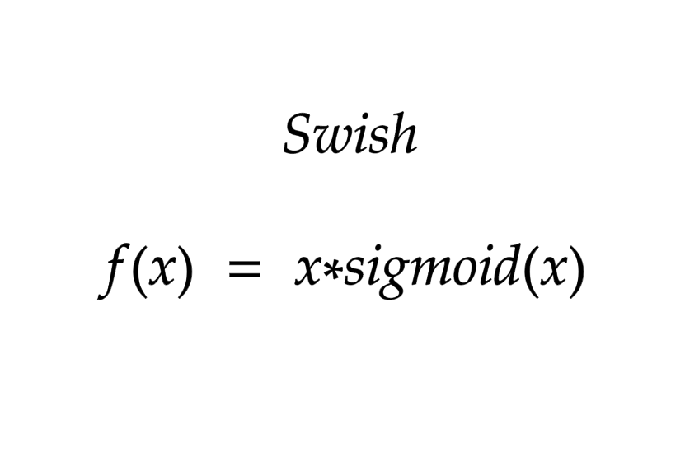
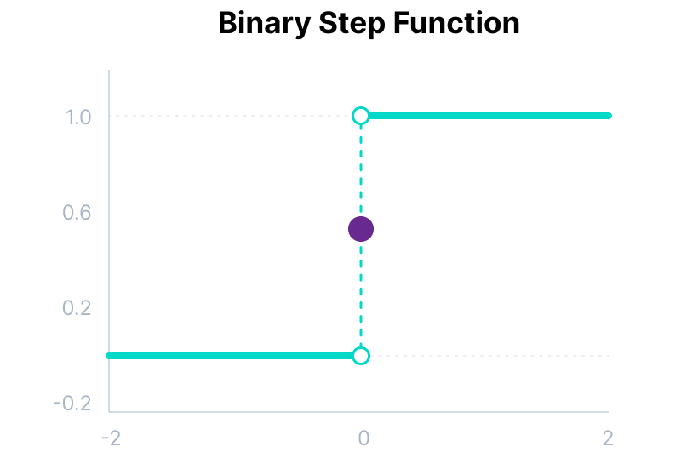
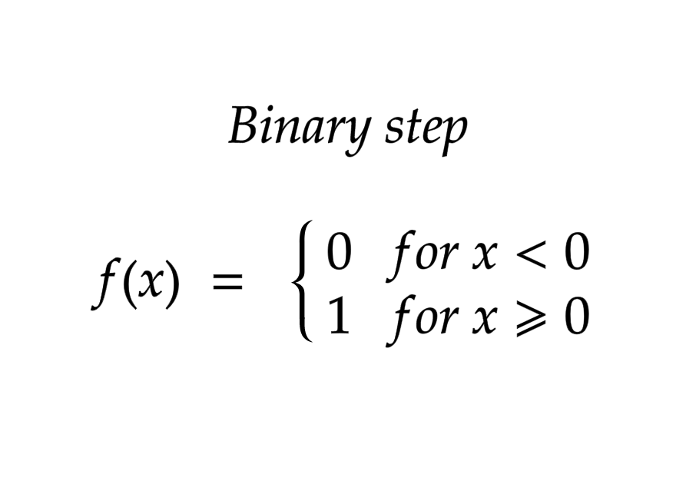
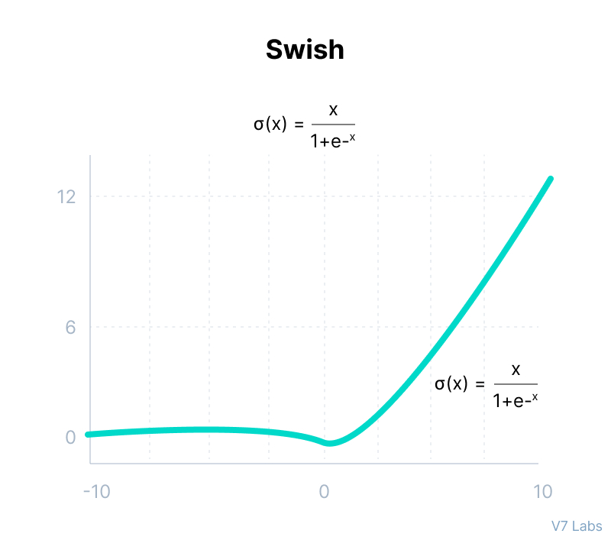
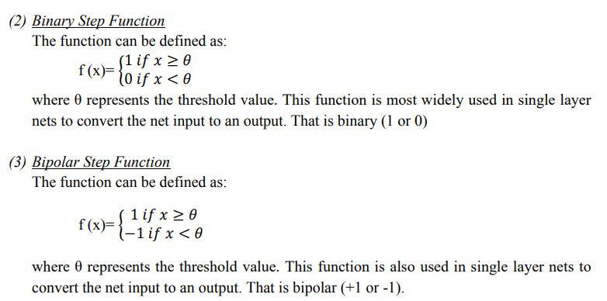

Slide 13
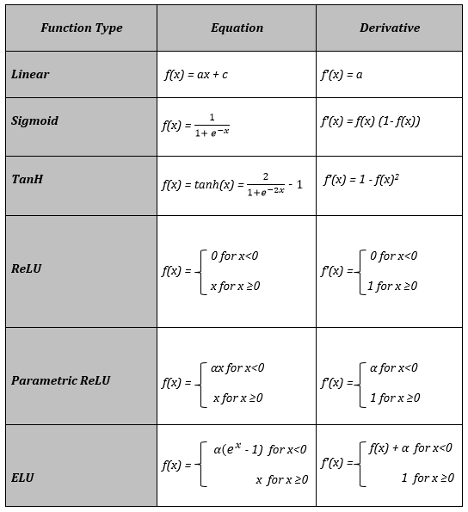

Slide 14
Forward propagation vs backward propagation in neural network
Below is the table for a clear difference between forward and backward propagation in the neural network.
Aspect | Forward Propagation | Backward Propagation
Purpose | Compute the output of the neural network given inputs | Adjust the weights of the network to minimise error
Direction | Forward from input to output | Backwards, from output to input
Calculation | Computes the output using current weights and biases | Updates weights and biases using calculated gradients
Information flow | Input data -> Output data | Error signal -> Gradient updates
Steps | 1. Input data is fed into the network. 2. Data is processed through hidden layers. 3. Output is generated. | 1. Error is calculated using a loss function. 2. Gradients of the loss function are calculated. 3. Weights and biases are updated using gradients.
Used in | Prediction and inference | Training the neural network

Slide 15
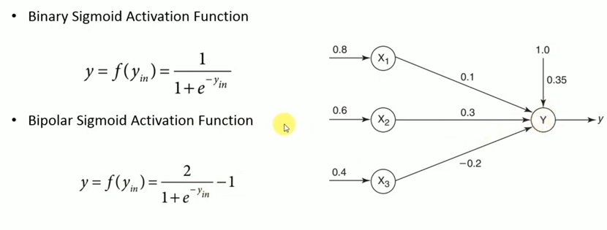
Problem-01:Obtain the output of the neuron Y using
Binary sigmoidal and
Bipolar sigmoidal activation function

Slide 16
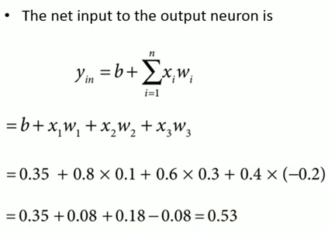
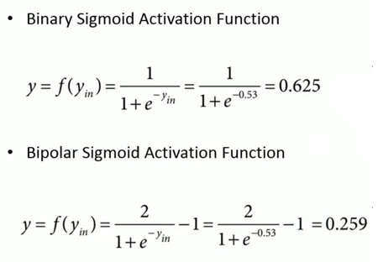

Slide 17
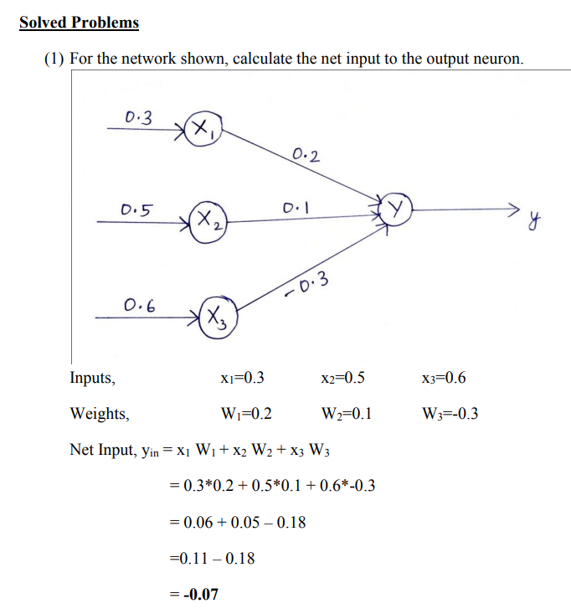
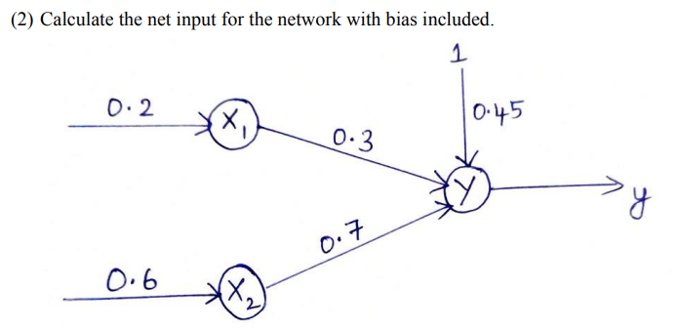
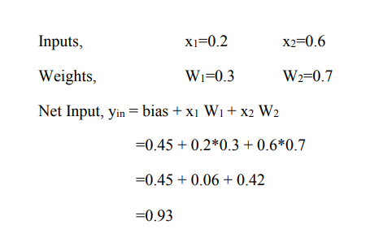

Slide 18
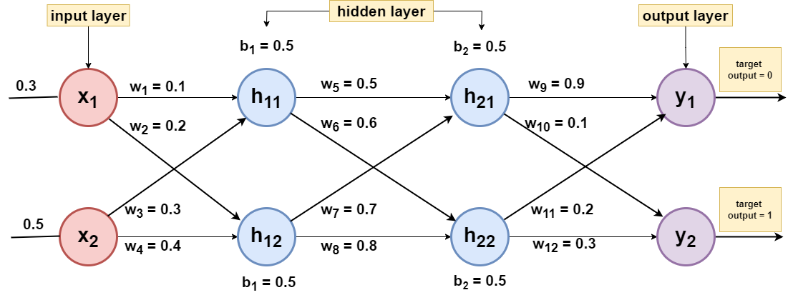
Problem-02: Obtain the output of the neuron Y using
Binary sigmoidal and
Bipolar sigmoidal activation function

Slide 19
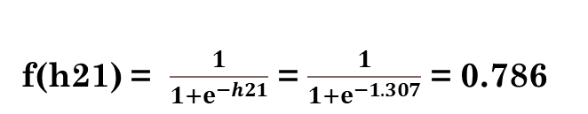
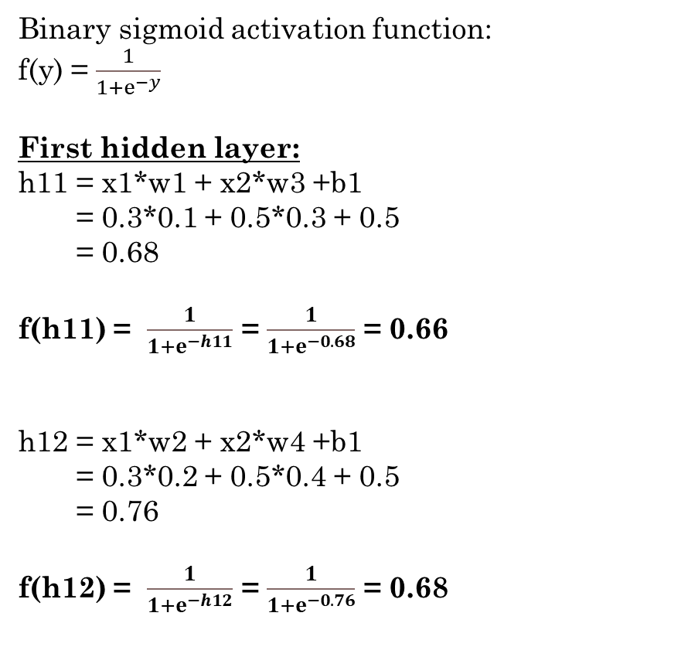
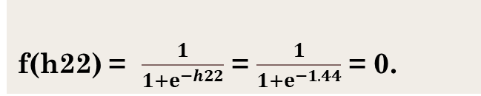
i) Solution : Obtain the output of the neuron Y using Binary sigmoidal activation function.
Binary sigmoid activation function:
f(y) = $\frac{1}{1+ⅇ^{−y}}$
First hidden layer:
h11 = x1*w1 + x2*w3 +b1
= 0.3*0.1 + 0.5*0.3 + 0.5
= 0.68
f(h11) = $\frac{1}{1+ⅇ^{−h11}}$ = $\frac{1}{1+ⅇ^{−0.68}}$ = 0.66
h12 = x1*w2 + x2*w4 +b1
= 0.3*0.2 + 0.5*0.4 + 0.5
= 0.76
f(h12) = $\frac{1}{1+ⅇ^{−h12}}$ = $\frac{1}{1+ⅇ^{−0.76}}$ = 0.68
Second hidden layer:
h21 = h11*w5 + h12*w7 +b2
= 0.66*0.1 + 0.68*0.3 + 0.5
= 1.306
f(h21) = $\frac{1}{1+ⅇ^{−h21}}$ = $\frac{1}{1+ⅇ^{−1.307}}$ = 0.786
h22 = h11*w6 + h12*w8 +b2
= 0.66*0.6 + 0.68*0.8 + 0.5
= 1.44
f(h22) = $\frac{1}{1+ⅇ^{−h22}}$ = $\frac{1}{1+ⅇ^{−1.44}}$ = 0.

Slide 20
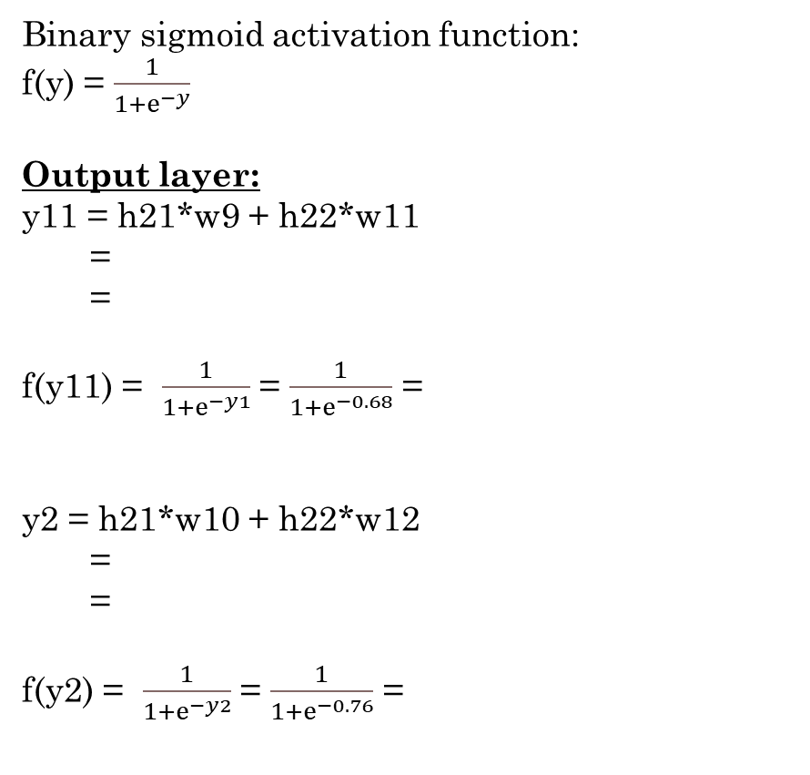
Binary sigmoid activation function:
f(y) = $\frac{1}{1+ⅇ^{−y}}$
Output layer:
y11 = h21*w9 + h22*w11
=
=
f(y11) = $\frac{1}{1+ⅇ^{−y1}}$ = $\frac{1}{1+ⅇ^{−0.68}}$ =
y2 = h21*w10 + h22*w12
=
=
f(y2) = $\frac{1}{1+ⅇ^{−y2}}$ = $\frac{1}{1+ⅇ^{−0.76}}$ =
Calculation of Loss: (Cross entropy or log loss)
Mean squared error = ½ [ (y1_{actual} – y1_{target})² + (y2_{actual} – y2_{target})² ]
= ½ [ ( - 0)² + (- 1)² ]
=
=

Slide 21

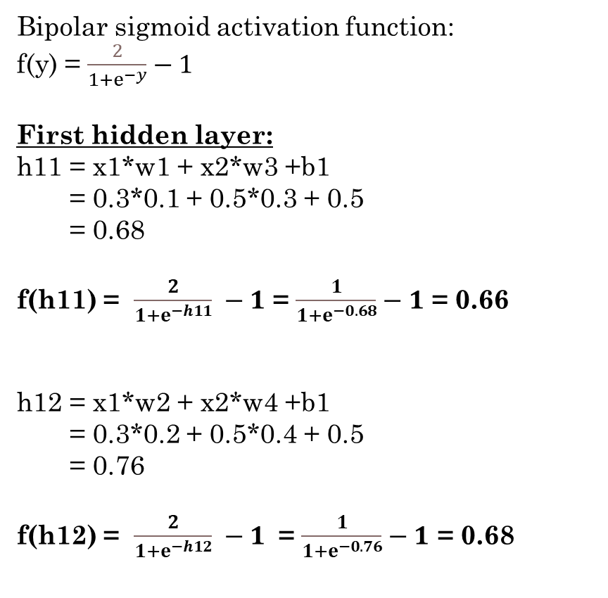

ii) Solution : Obtain the output of the neuron Y using Bipolar sigmoidal activation function.
Bipolar sigmoid activation function:
f(y) = $\frac{2}{1+ⅇ^{−y}}−1$
First hidden layer:
h11 = x1*w1 + x2*w3 +b1
= 0.3*0.1 + 0.5*0.3 + 0.5
= 0.68
f(h11) = $\frac{2}{1+ⅇ^{−h11}} −1$ = $\frac{1}{1+ⅇ^{−0.68}}−1$ = 0.66
h12 = x1*w2 + x2*w4 +b1
= 0.3*0.2 + 0.5*0.4 + 0.5
= 0.76
f(h12) = $\frac{2}{1+ⅇ^{−h12}} −1$ = $\frac{1}{1+ⅇ^{−0.76}}−1$ = 0.68
Second hidden layer:
h21 = h11*w5 + h12*w7 +b2 = 0.66*0.1 + 0.68*0.3 + 0.5
= 1.306
f(h21) = $\frac{2}{1+ⅇ^{−h21}}−1$ = $\frac{2}{1+ⅇ^{−1.307}}−1$ = 0.786
h22 = h11*w6 + h12*w8 +b2 = 0.66*0.6 + 0.68*0.8 + 0.5
= 1.44
f(h22) = $\frac{2}{1+ⅇ^{−h22}}$ = $\frac{2}{1+ⅇ^{−1.44}}−1$ = 0.

Slide 22
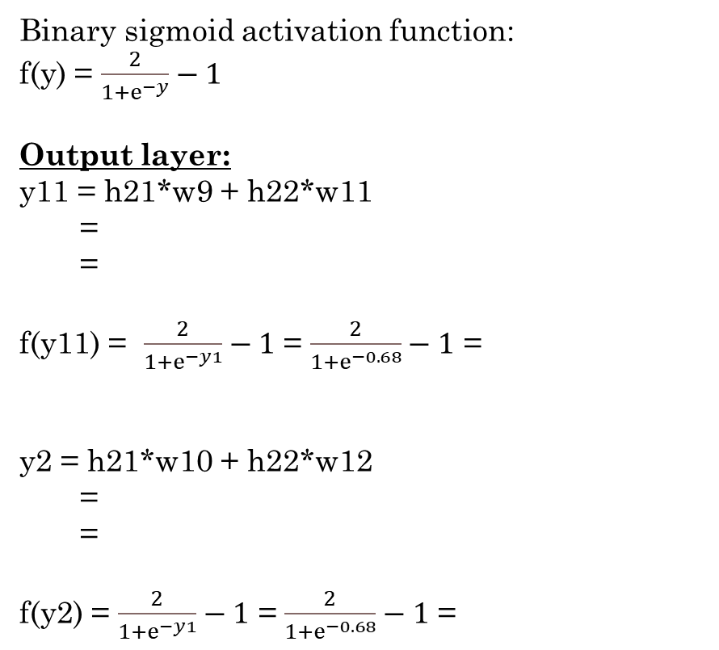
Binary sigmoid activation function:
f(y) = $\frac{2}{1+ⅇ^{−y}}−1$
Output layer:
y11 = h21*w9 + h22*w11
=
=
f(y11) = $\frac{2}{1+ⅇ^{−y1}}−1$ = $\frac{2}{1+ⅇ^{−0.68}}−1$ =
y2 = h21*w10 + h22*w12
=
=
f(y2) = $\frac{2}{1+ⅇ^{−y1}}−1$ = $\frac{2}{1+ⅇ^{−0.68}}−1$ =
Mean squared error = ½ [ (y1_{actual} – y1_{target})² + (y2_{actual} – y2_{target})² ]
= ½ [ ( - 0)² + (- 1)² ]
=
=

Slide 23
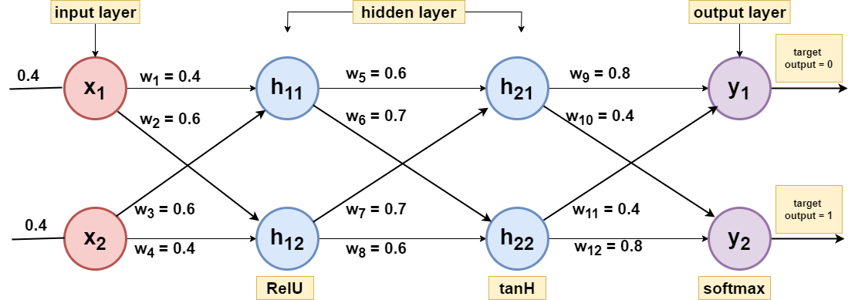
Problem-03: Obtain the output of the neuron Y

Slide 24
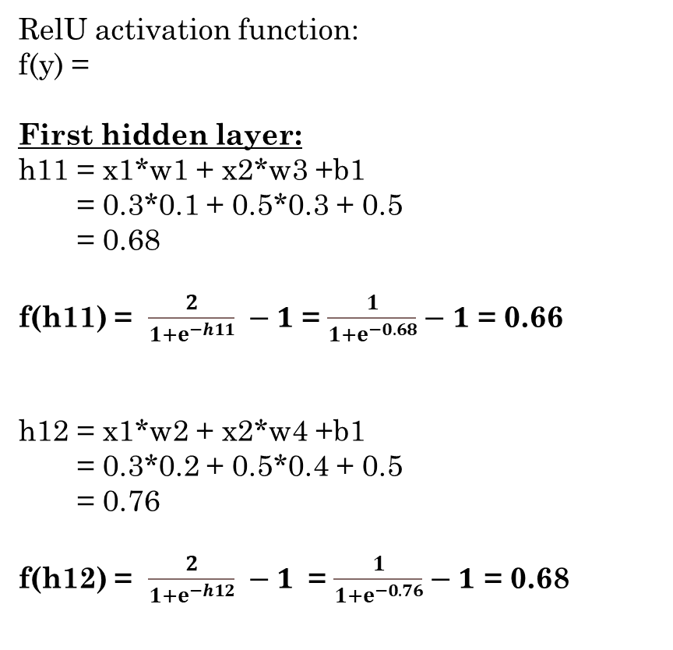
Solution :
RelU activation function:
f(y) =
First hidden layer:
h11 = x1*w1 + x2*w3 +b1
= 0.3*0.1 + 0.5*0.3 + 0.5
= 0.68
f(h11) = $\frac{2}{1+ⅇ^{−h11}} −1$ = $\frac{1}{1+ⅇ^{−0.68}}−1$ = 0.66
h12 = x1*w2 + x2*w4 +b1
= 0.3*0.2 + 0.5*0.4 + 0.5
= 0.76
f(h12) = $\frac{2}{1+ⅇ^{−h12}} −1$ = $\frac{1}{1+ⅇ^{−0.76}}−1$ = 0.68

Slide 25
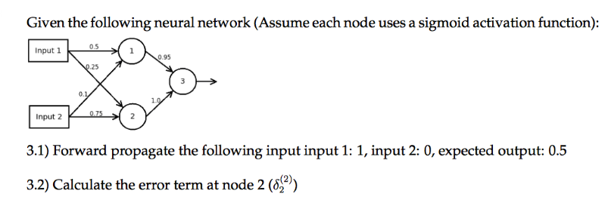
Problem-04: Obtain the output of the neuron Y

Slide 26
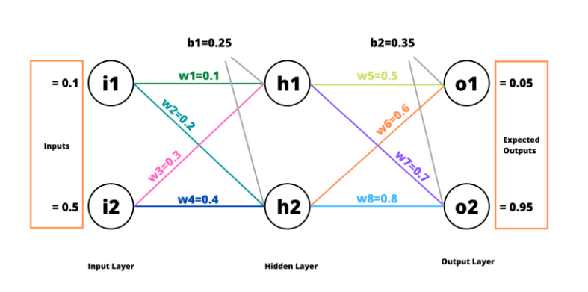
Problem-05: Obtain the output of the neuron Y

Slide 27
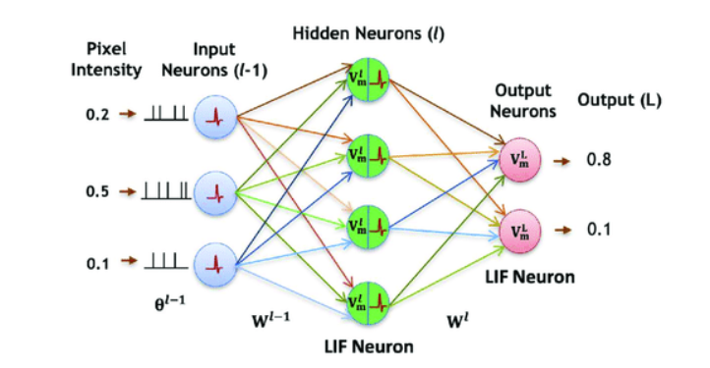
Problem-06: Obtain the output of the neuron Y

Slide 28
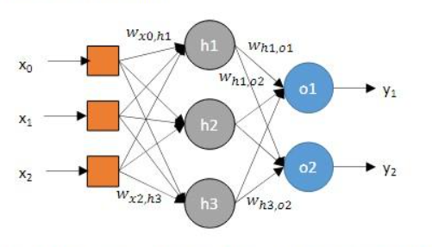
Problem-07: Obtain the output of the neuron Y

Slide 29
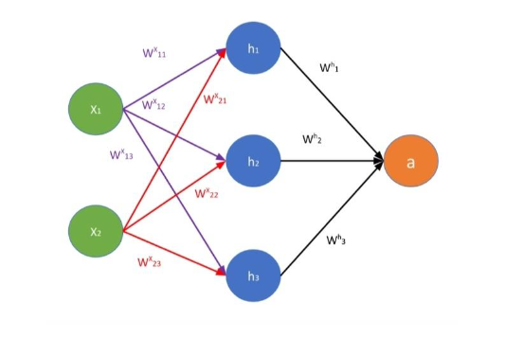
Problem-08: Obtain the output of the neuron Y

